Slide 1
Career Planning for Graduate Students & Postdocs
Tithi Basu Mallik, PhD (she/her)
Assistant Director for Graduate/Professional Students & Postdoctoral Career Support
tithi.basu-mallik@uky.edu

Slide 2
Shrinking Academic Jobs

Slide 3
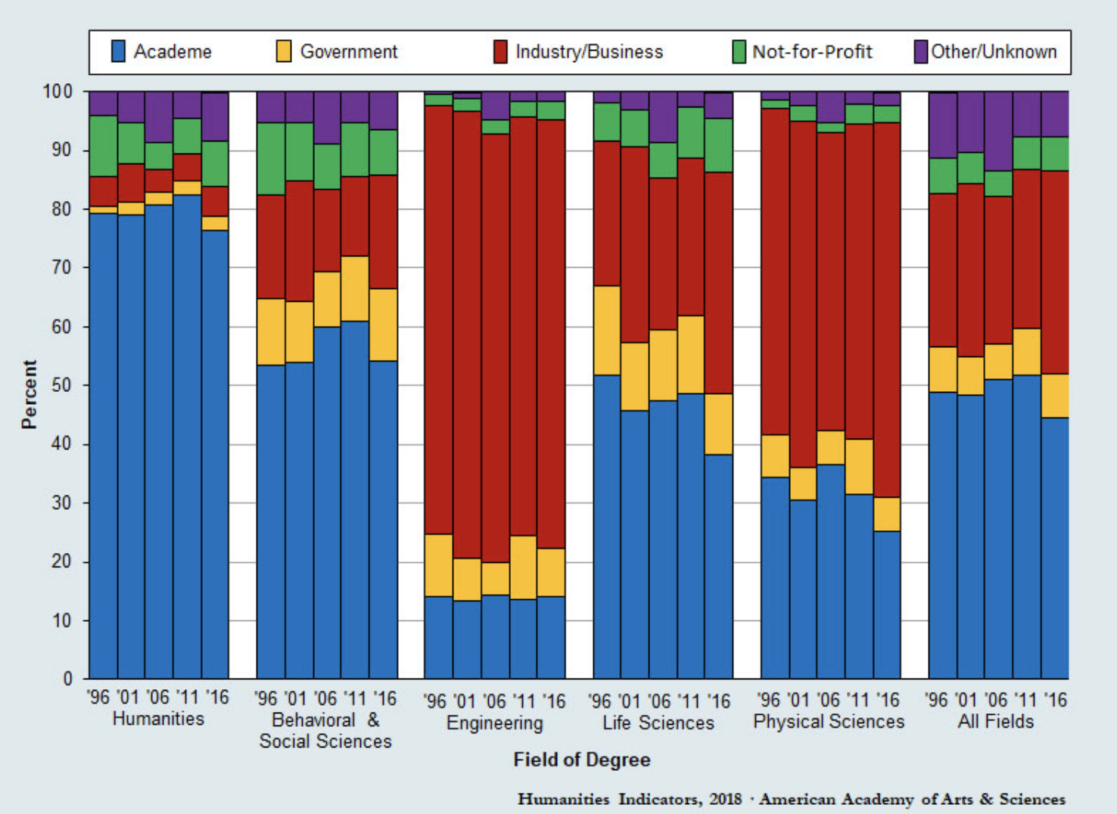
Employment Sector of Doctorate Recipients with a Definite Postgraduation U.S. Employment Commitment Selected Academic Fields, 1996–2016*
https://www.amacad.org/humanities-indicators/workforce/job-status-humanities-phds-time-graduation

Slide 4
Session Overview
Career planning
Self-assessment
Research resources and strategies
Planning & Goal Setting
Turn plan to action

Slide 5
Design Your Career
Assess
Research
Synthesize
Implement

Slide 6
Self-Assessment

Slide 7
Your Career Fit
Values
Skills
Interests
Career matches

Slide 8
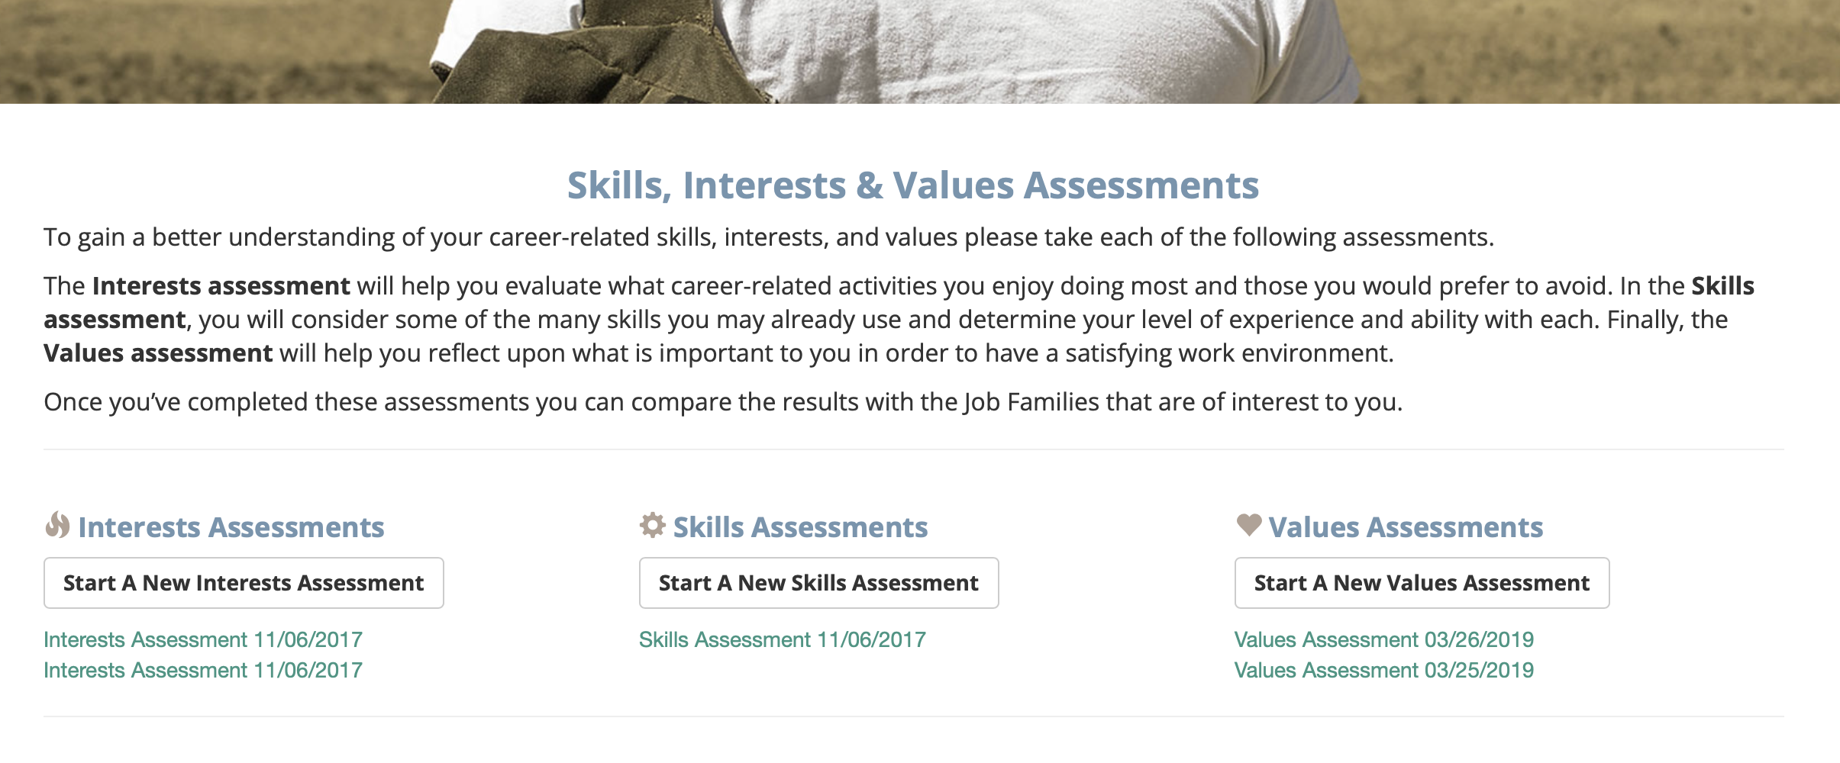

Slide 9
MyIDP

Slide 10
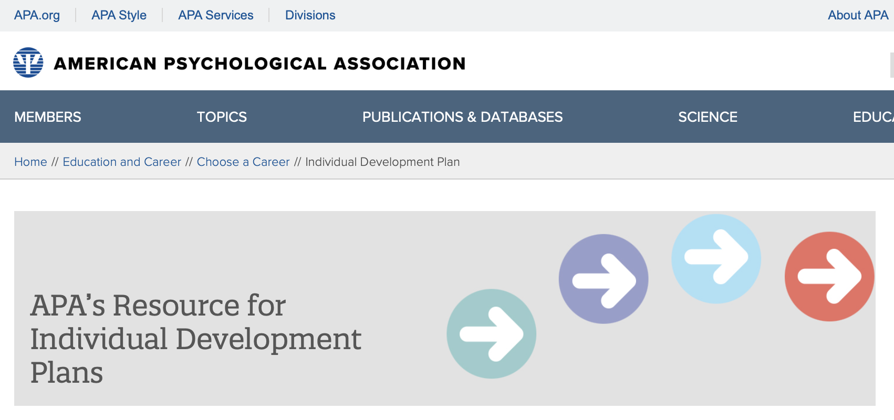
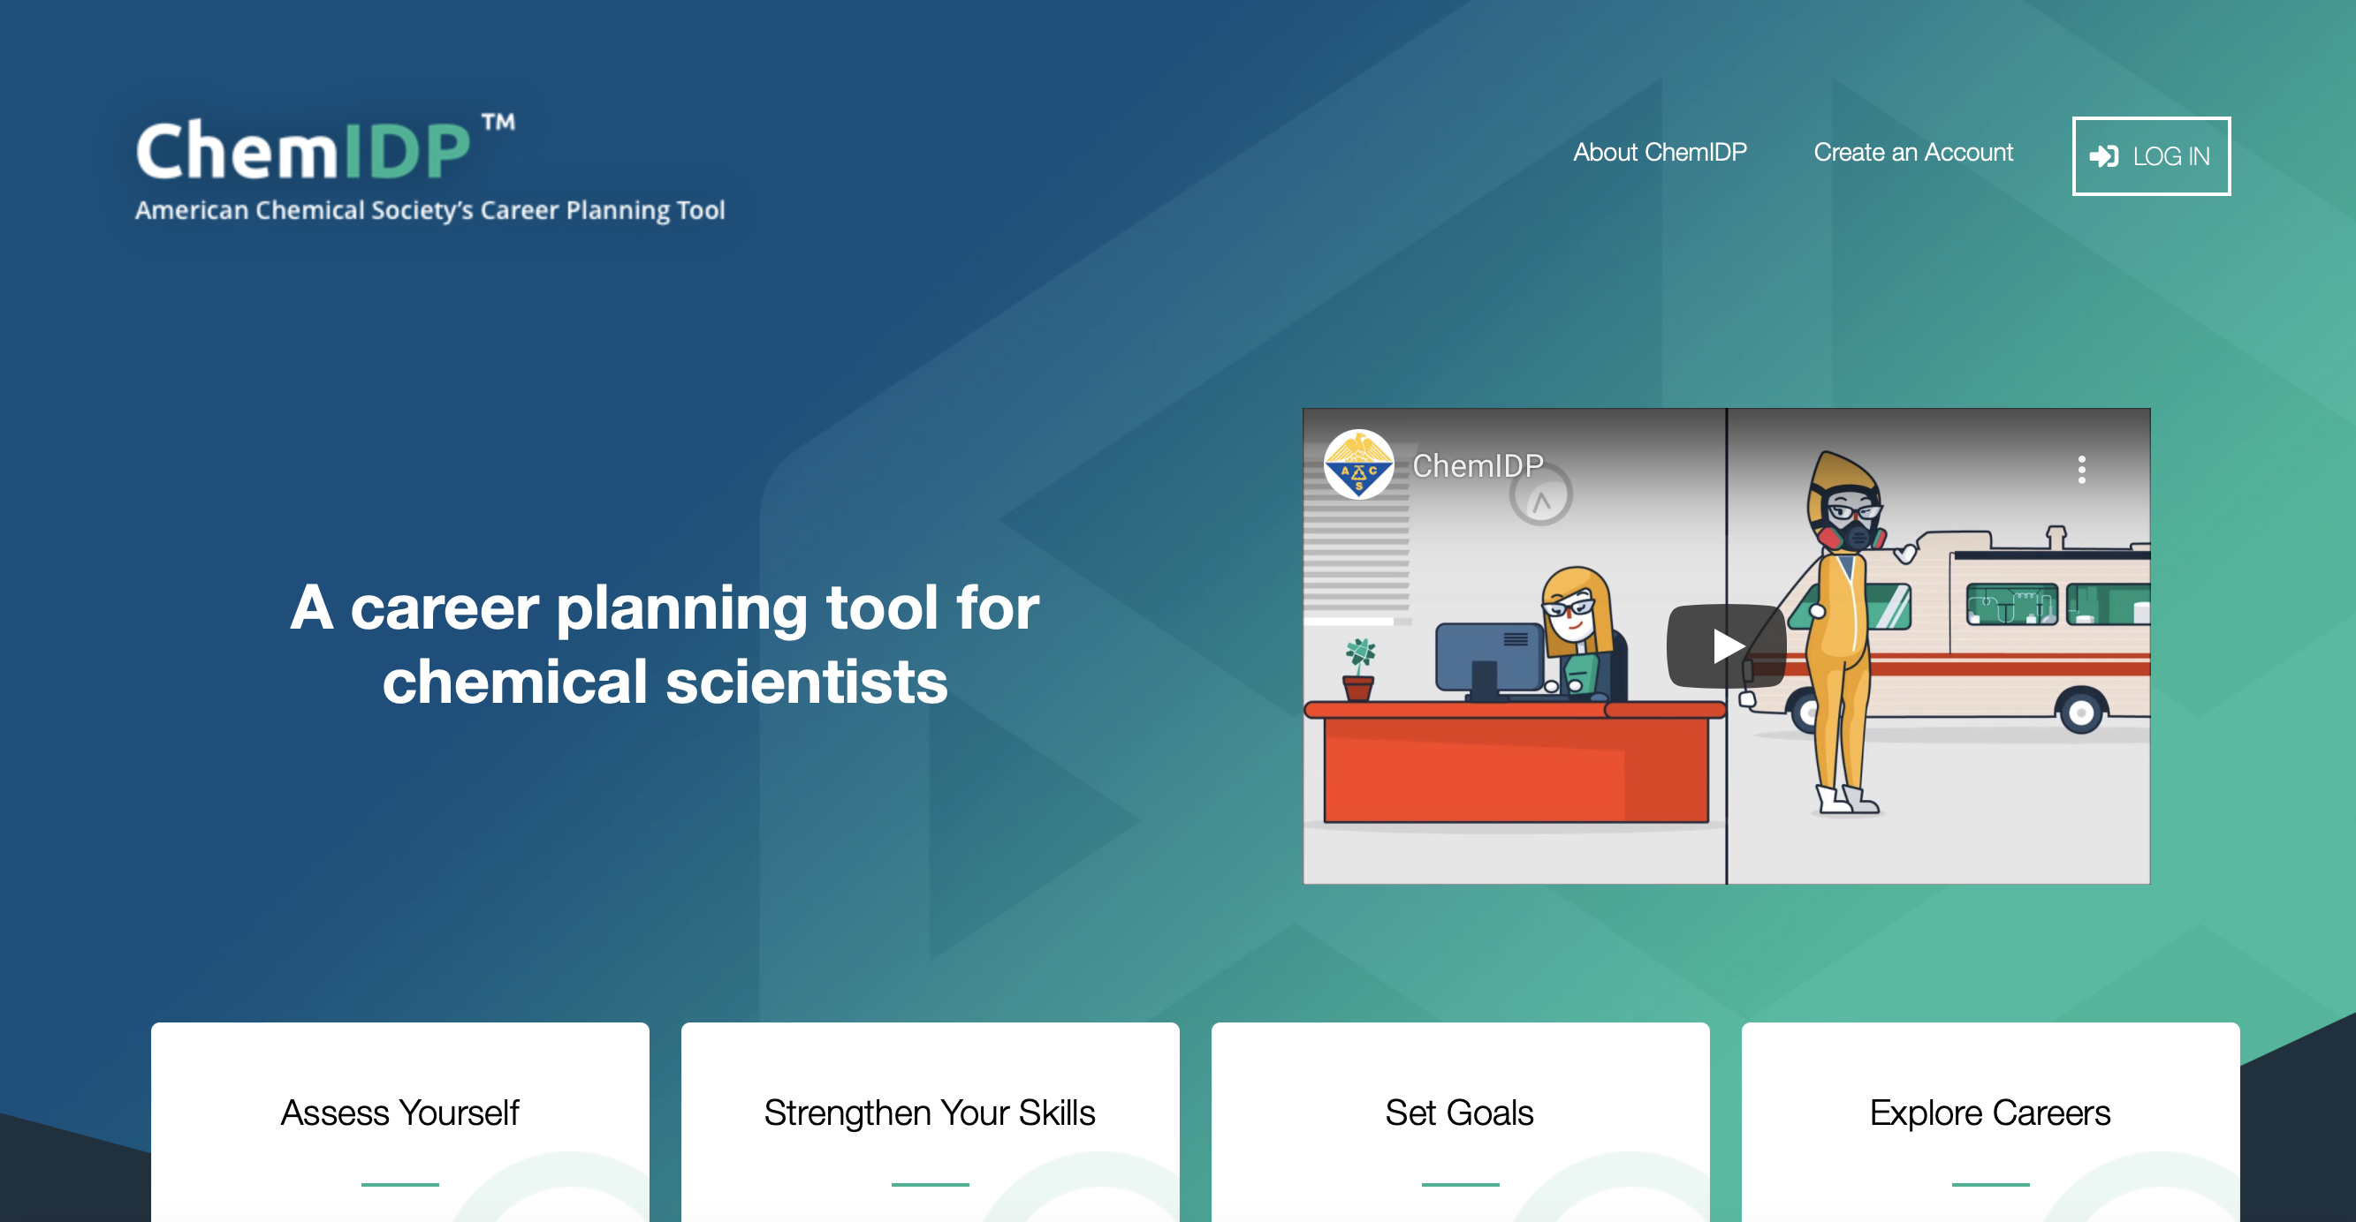
Additional
APA IDP
Chem IDP
More…

Slide 11
Personality Assessment Tools

Slide 12
Research

Slide 13
Job posts for Career Exploration
Job titles
Relevant skills
Competencies
Experiences
What do you link?
What do you dislike?
Helpful article: https://www.insidehighered.com/advice/2017/04/03/examining-various-jobs-ads-can-help-you-explore-your-career-essay

Slide 14
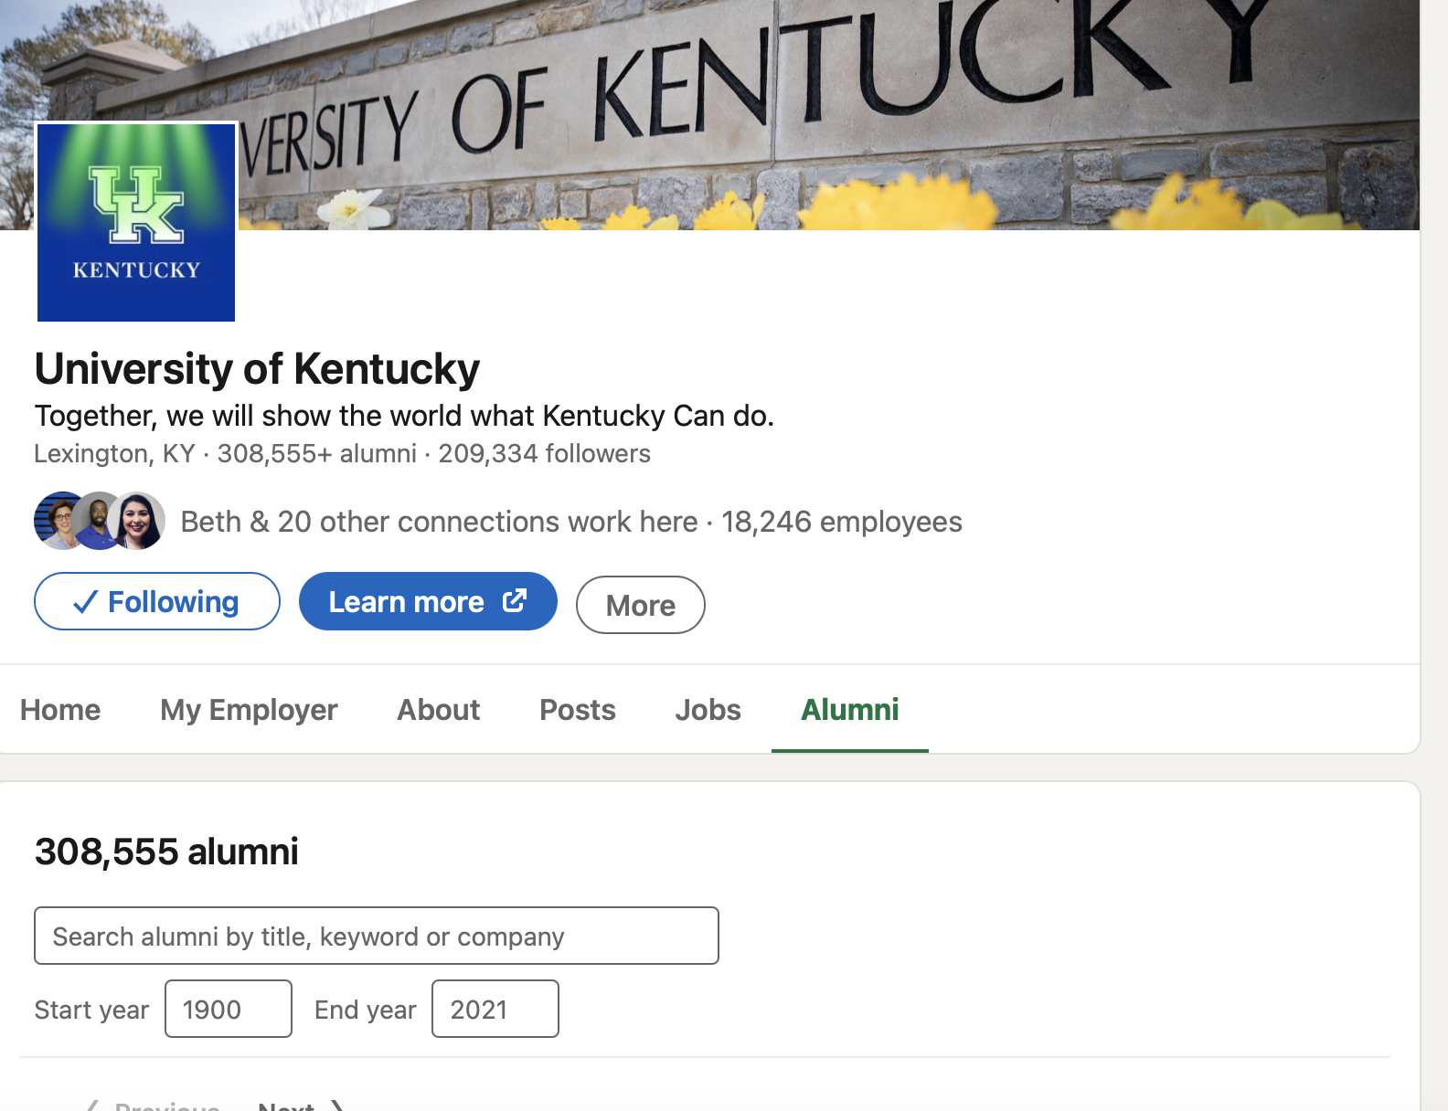
Explore connections
Alumni careers
People in jobs of interest
People from similar academic backgrounds
Seek connections
Discuss your career interests

Slide 15
Informational Interviewing
Learn about career trajectories
Successful strategies
Insights into job sectors/roles/organizations
Other people to connect with
Stay in touch

Slide 16
Synthesize

Slide 17
Synthesize Assessment + Research
Reflect on learning
What pathways do you want to pursue?
What skills/ competencies/experiences are required?
What are the gaps?
How to fill the gaps?

Slide 18
Goal Setting

Slide 19
SMART Goals
S – Specific
Is it focused and unambiguous?
M – Measurable
Could someone determine whether or not you achieved this goal?
A – Action-oriented –
Did you specify the action you will take?
R – Realistic
Considering difficulty and timeframe, is this goal attainable?
T – Time-bound
Did you specify a deadline?

Slide 20
Individual Development Plan

Slide 21
Implement

Slide 22
Build Skills/ Competencies
Curricular or co-curricular learning
Align research, if possible
Bootcamps
Online courses
Projects

Slide 23
Gain Experiences
Internships
Institutional opportunities
Volunteer work
Graduate/postdocs organizations
National professional associations

Slide 24
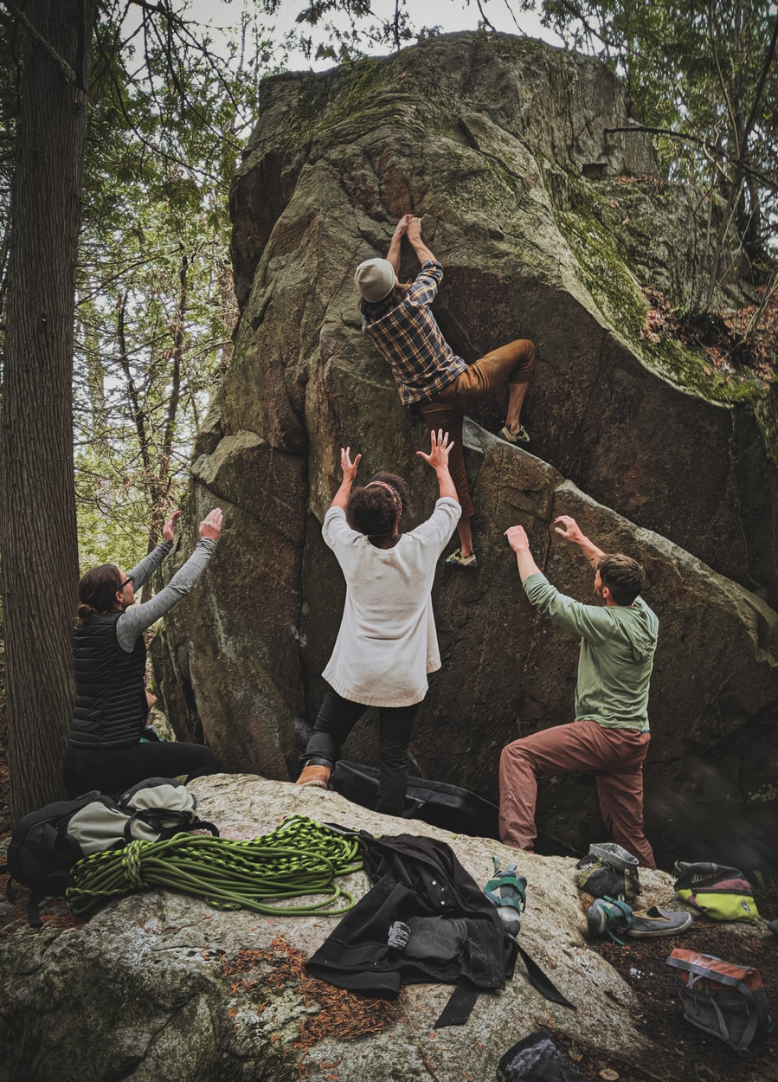
Build Community
Mentors
Professionals
Other graduate students/postdocs
Faculty
Staff
Helpful article: https://www.insidehighered.com/advice/2021/11/15/benefits-phds-having-multiple-mentors-opinion

Slide 25
Additional Resources

Slide 26
Questions?
Email : Tithi.basu-Mallik@uky.edu
For advising appointments :
https://uky.joinhandshake.com

